Slide 1
Fog of War in videogames
Oscar Pérez Martín

Slide 2
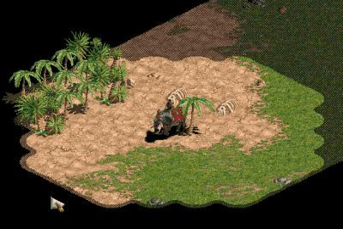
Fog of War (FoW)
What does FoW mean?
What is it used for in video games?
Strategy-> Prediction, Intel Gathering
Adventure/Roleplay-> Exploration
Age of Empires

Slide 3
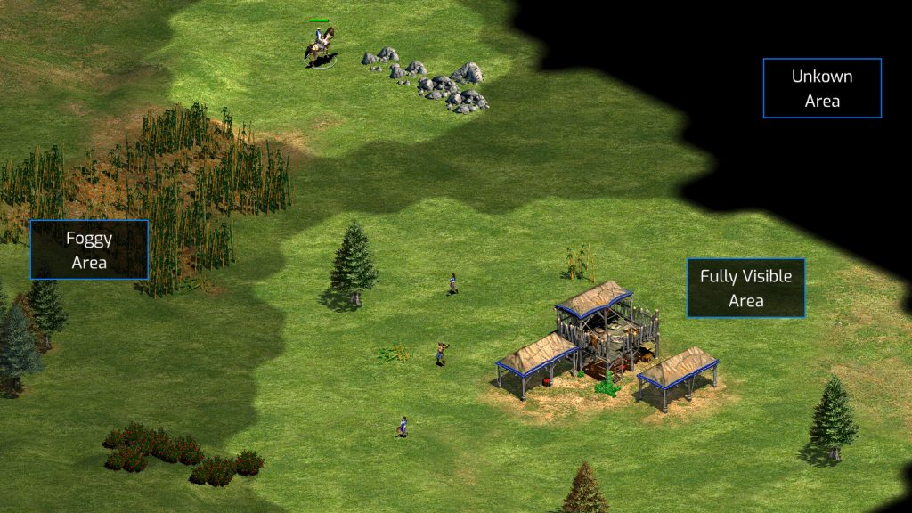
FoW Characteristics - Distinctive features
Gameplay related: fog & shroud
Fog: Some (little) information, half opacity. Seen back in time.
Shroud: No information, fully occluded map.
Age of Empires

Slide 4
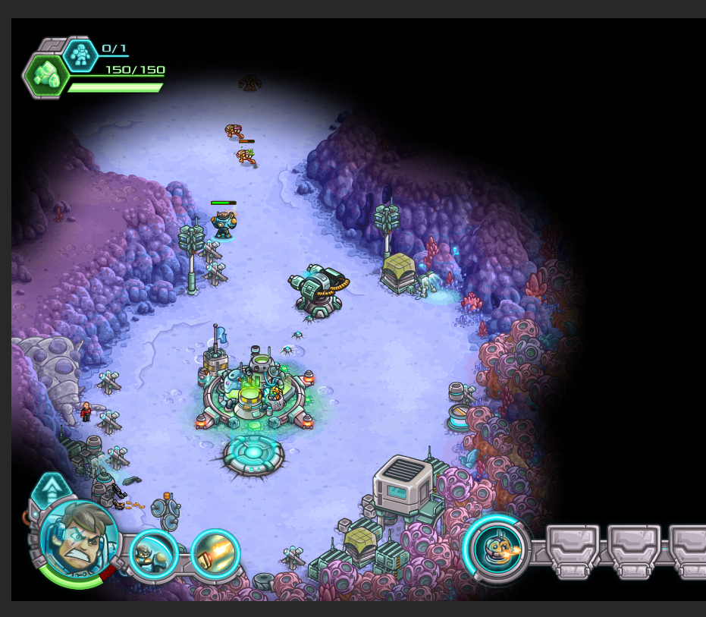
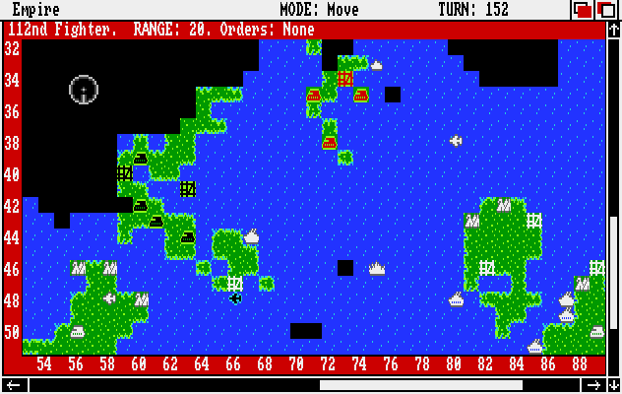
FoW Characteristics - Distinctive features
Aesthetics related: “Chunky” vs “Smooth” fog
Empire
Iron marines

Slide 5
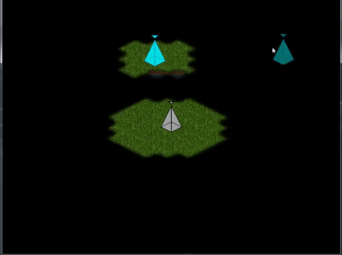
My implementation
Smooth FoW
Fog & Shroud
Bitmasking

Slide 6
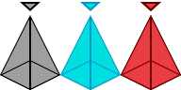
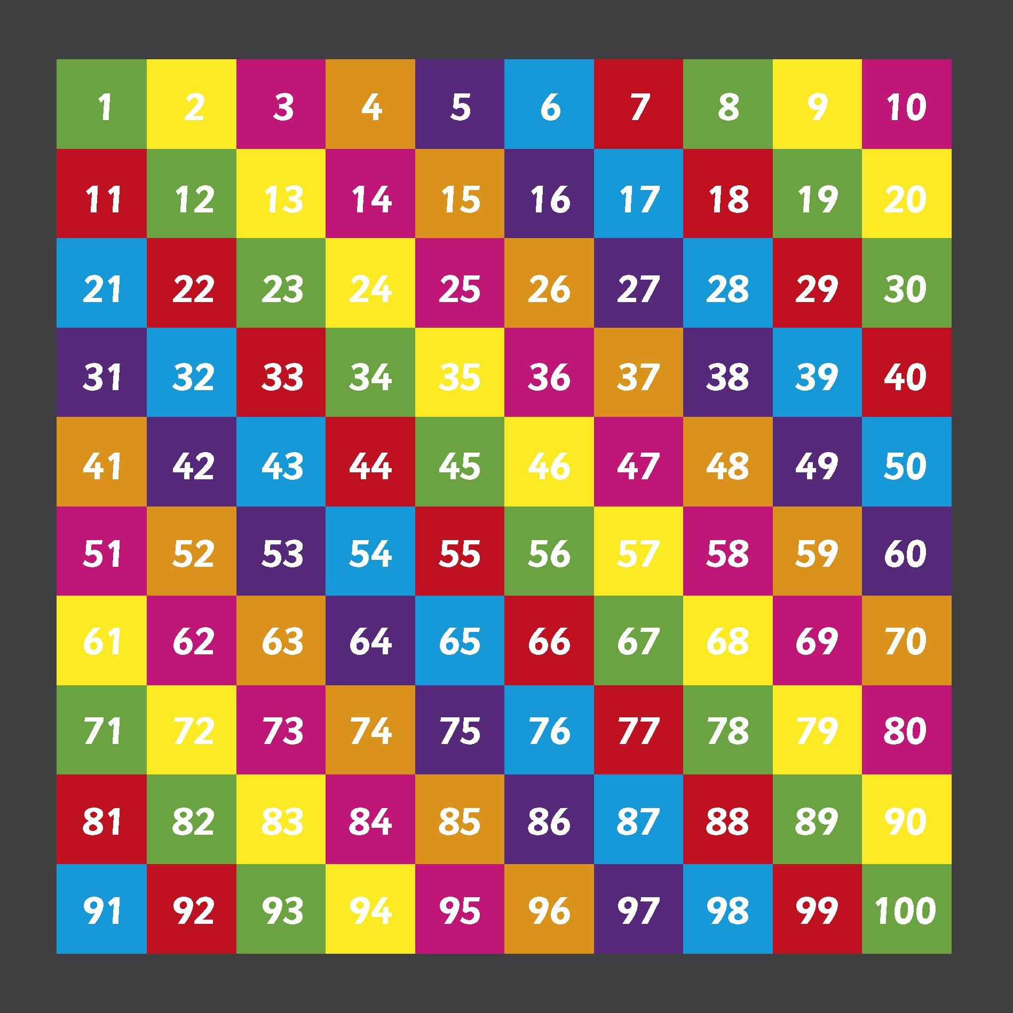

Code Structure
FoW Entites
FoW Manager
Smoothed Textures

Slide 7
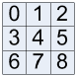
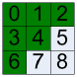
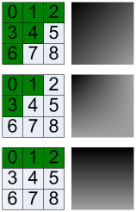
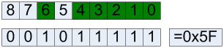
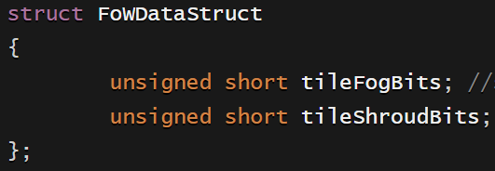
Bitmasking: Sub-Pixels
Sub-pixels
The map stores instances of this struct

Slide 8
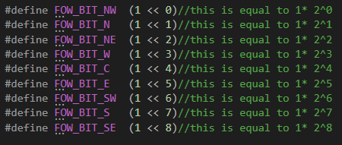
Bitmasking: Bit definitions
Just for simplicity & readability

Slide 9
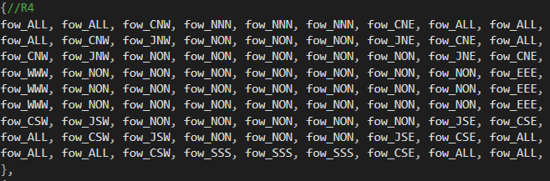
Bitmasking: Shape masks
Shape mask for a circle of radius 4

Slide 10
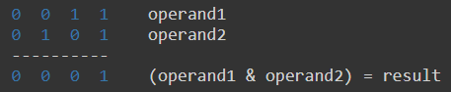
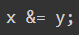
Bitmasking: Applying the mask
1 on 1 bitwise ANDing
Mask

Slide 11
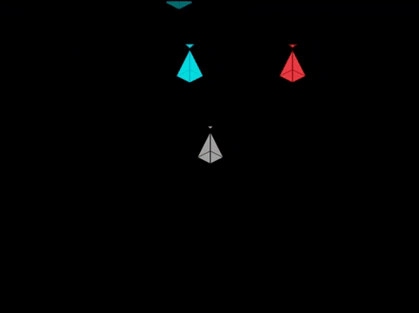
TODO 1 - Creating the FoW Map
To start making fog of war we first need a map in which we will store the fog of war data of every tile. So go ahead and create your first FoW map!
Result:

Slide 12

TODO 2 to 2.3 - Creating FoW Entites
In this series of TODO’s you will learn how the FoW entities work:
In TODO 2 you will learn how to create them and where are they stored
In TODOs 2.1 to 2.3 you will learn how are they linked with normal entities
Result:

Slide 13
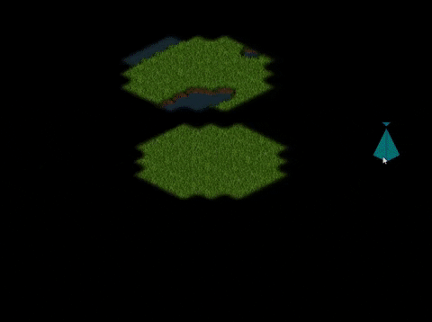
TODO 3 - Applying the Bitmask
The real deal! In this TODO you have to apply a precomputed mask to each affected tile in the FoW map data.
I recommend you to check TODO 3.1 in the code if you want to take a look to the sub-pixel definitions
If you have trouble with Bitwise operators check these links:
Bitwise operators
How do Bitwise operators work
Result:

Slide 14
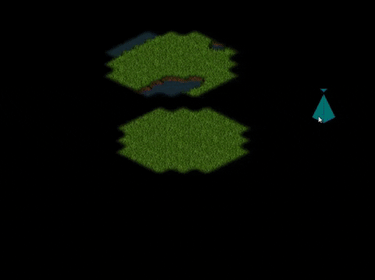
TODO 4 to 4.1 - Moving the FoW Entity
As you might have noticed, altough you move the player the masks stays still. We are going to change this now.
Result:

Slide 15
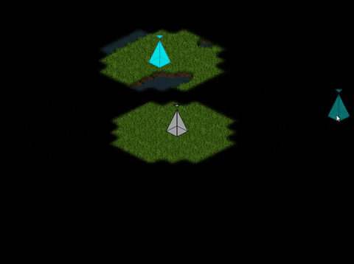
TODO 5 - Check tile visibility
We are almost done! There is only one thing left to do. We just need a way for the entities to know when they are visible or not.
So we are going to complete a function that tells the entities whether they are on top of a visible tile or not.
Result:

Slide 16
Homework
Check the FoWManager function DrawFoWMap() and make sure you understand how it draws FoW tiles.
Try to create your own precomputed shape mask

Slide 17
Improvements
I now have a FoW entity for every entity of the project, which keeps the project at a steady 60+ fps even with 100+ units. Nevertheless, you should consider grouping your entities and let them have just one FoW Entity for each group in case you want to have a lot of units together in one place to avoid re-checking the same tiles over and over again.
You can combine the unit move check that exists in my code with a timer to perform the check every now and then. Between 0.25 and 0.5 sec will be fine in most cases.

Slide 18
Thank you for your time!

